Slide 1
Managing Agency E&O Exposure to Data Breaches and Cyber Liability
Corporate Solutions
A value-added risk management service of the Big “I” Professional Liability Program and Swiss Re Corporate Solutions.

Slide 2
Today’s Topics
Data privacy laws affecting agents
Protected information and agency exposures
Accepted methods for protected data
Tools available to enhance knowledge and implementation for agencies
Insurance remedies to protecting the agency
Offering coverage to customers
We have alot to cover today!

Slide 3
Feb. 8th - Cyber Risk Webinar Opportunity from IIABA
This webinar identifies existing and evolving cyber risk exposures, details why traditional insurance products are inadequate to manage these exposures, and outlines potential solutions from ISO standard products and various specialty programs available in the insurance marketplace. At the conclusion of this webinar, participants should be able to: • Grasp the significance and magnitude of cyber exposures • Understand why traditional standard insurance products are inadequate to address these exposures • Differentiate between various ISO solutions and recognize why most are inadequate • Identify what non-ISO specialty products cover or should cover
TO REGISTER: Visit the Upcoming Webinars section of www.iiaba.net or click here.

Slide 4
Our Panelists
Celeste King - A partner with the Chicago-based law firm of Walker Wilcox Matousek LLP: She advises insurers and reinsurers on coverage for cyber risks and privacy breaches involving first party and third party policies
Steve Aronson – President and CEO of Aronson Insurance Agency, Inc (20 employees).: An agency owner who is also an insurance educator and technology expert. He serves on various national insurance committees (ACT, ACORD, AUGIE and NetVU).
Tim Woodcock – President and CEO of Courtesy Computers, Inc.: His firm provides IT consulting, network assessments, and managed IT services for insurance agencies.
Jeff Yates – Executive Director of IIABA’s Agents Council for Technology (ACT).: He works with independent agents, companies, vendors, user groups and industry associations to advance effective technology solutions and business processes for the IA system.
Alex E. Wayne – Executive Vice President of A.J. Wayne and Associates, Inc.: A wholesale broker specializing in professional liability, providing retail agents with access and expertise for cyber liability coverage.
Susan Dowdall – Senior Vice President at Swiss Re Corporate Solutions: Team leader for the Insurance Agents E&O Program.

Slide 5
Legal Perspective

Slide 6
Why Privacy Rules Apply to Agents
Celeste you’re going to provide some legal perspective, can tell us about what laws affect agents including what information needs to be protected?
Understanding Breach and Privacy Rules: Privacy Is Legally Protected
Electronic Data is Part of Your Business (Not Just “Big Business”)
Privacy Rules Also Apply to Paper Docs: Know How to Dispose of Them
State Insurance Commissioners Investigating Breaches and Fining

Slide 7
What is PII or PHI?
●Common Sense Items
→Financial Information
→Drivers License
→Social Security Number
→Medical Insurance Numbers
●Other Items
→Address, Phone Number, Zip Code
→Maiden Name
→Date of Birth
→Place of Employment

Slide 8
Laws That Apply
46 States + D.C. Notification Laws (www.ncsl.org)
Federal Laws
→Gramm Leach Bliley
→FACTA
→Red Flag Rules
Noteworthy State Laws
→Massachusetts
→Connecticut
→California

Slide 9
Massachusetts
Effective March 1, 2010
One of the Toughest in the U.S.
Who Does it Apply To?
Can a Breach be “Excused?”
Written Information Security Plan (WISP)
→What PII Do You Control?
→How Do You Control PII?
●Encryption
●Employee Training

Slide 10
Connecticut Insurance Department
State of Connecticut Insurance Department Bulletin IC-25
Issued August 18, 2010
CID Rules in addition to Connecticut General Laws on Privacy
No “Safe Harbor” for Encrypted Data
Covered Business Must Notify CID of PII Breach in Five Days
Notification due within 5 days of breach
Covered Businesses Must Manage Vendors’ Use of PII
CID Can Impose Fines, Penalties and “Administrative Actions”

Slide 11
California
First State to Enact Breach Notification Rule
Amendments Dated August 31, 2011 Toughen Notification Requirements
Applies if Data Unencrypted
Notice Required to Californian Consumers No Matter the Breach Location
Department of Insurance Softening Rules (But Only For California Agents)

Slide 12
Agent Perspective

Slide 13
What to protect and how much do you need to do to protect it?
Steve talk to us about the types of information that agencies need to protect and the areas of exposure to breach of data that most agencies have, including both internal and external exposures?
THE SMELL TEST…………..
Imagine sitting on the witness stand, at your data-theft trial. The plaintiff’s attorney asks you about what you did to protect your client’s personal information.
Be sure you are managing your agency so that you can give a very good answer to the judge and jury.

Slide 14
Physical protections for your office
Locks on doors and windows
Central station burglar alarm – that is used very night
An extra lock on the computer room/closet

Slide 15
Protect the paper
Do you throw policy declarations pages away in the trash?
Imagine hauling the plastic trash bag to the dumpster – and it breaks. Policy dec pages are blowing all over the parking lot and down Main St.
Or, kids dumpster-diving take the policy pages and … ugly!
Shred them yourself (not efficient use of your time) or hire a shredding company

Slide 16
Protect the Electronic Data
Management System
Most are secure – but ask them to put it in writing
ASP (cloud based systems) are probably safer
In-house – your server may be the weak link
How about ID’s and Passwords?
Are any on yellow Post-it notes stuck on the wall?

Slide 17
Protect the Electronic Data
Rating and Scanning/Imaging Systems
Same as Management System

Slide 18
Protect the Electronic Data
Your Server(s)
Consider bolting them to the floor or wall
Use strong passwords
Minimum 8 characters, Upper, lower, numeral (symbol)
Example ALNHf7s#
No names, pets, birthdays
Must be changed every 60 days
Use strong anti-virus and malware protection
Definitions must update daily or continuously

Slide 19
Protect the Electronic Data
Desktop PC’s
Strong passwords – same as Server
Set it up so that the Server REQUIRES that they be changed every 60 days
Use strong anti-virus and malware protection – updated daily

Slide 20
Protect the Electronic Data
Laptops, iPads, and Thumbdrives
They most likely contain emails or other PI
Strong passwords
Don’t EVER leave them in the car while you are getting a coffee
Avoid storing client data on them if at all possible. Use the cloud.
iPhones (all smartphones)
Strong passwords (yes, even on your phone)
Don’t allow staff to plug them into the USB port on their desktop PC to charge them as virus/malware may transfer to the PC

Slide 21
Protect the Electronic Data
Backup tapes and drives
Must be secure
Never leave them in the car
Home PC’s and other remote access devices
Be sure they are password protected
Use strong anti-virus and malware protection – updated daily

Slide 22
Protect the Electronic Data
The elephant in the room: Email!
Secure Email is required whenever sending out emails that contain PI
TLS – Transport Layer Security is the standard
Used by most insurance companies
Easy and inexpensive to set up and maintain
All emails between agent-company are secure
Tim will elaborate
Other options for emails to others (like a partially completed auto insurance app sent to a client)
Must be easy to use for the client/prospect or it is a barrier to a sale
Must be easy to use for CSRs/Producers or they won’t use it
Must be affordable
Tim will elaborate

Slide 23
IT Perspective

Slide 24
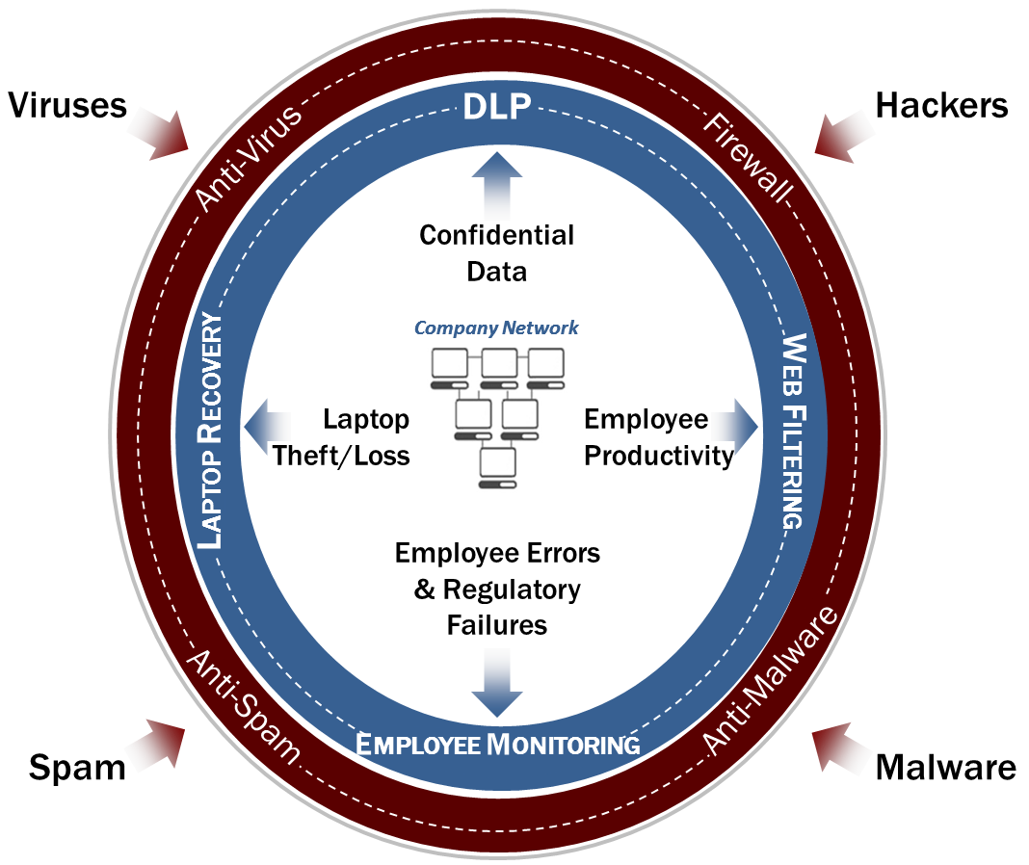
Network Protection
Tim, I think a lot of agencies out there look at IT security costs as an expense headache but before we get into more detail on this, you say that good security can benefit the agency’s bottom line, how?
Notes:
How can security benefit the agency’s bottom line?
Properly Implemented and managed Security leads to an increase in agency productivity (i.e. preventable system downtime & productivity due to attacks, poorly managed networks, unmanaged employees)
Time is money:
$20 per hour per employee
1 hour of ‘avoidable’ lost productivity per employee per day = A loss of $5,000 per year
20 user office = $100,000 per year in lost income.

Slide 25
Security Policy
The first step agencies need to do is to create an agency security policy, can you provide some guidance to agents on what should be included in their policy and how to develop one?
Appoint an Information Security Coordinator & involve your employees
Perform a Security Assessment
Develop a strong written information security plan (www.iiaba.net/act)
Implement and enforce the policy
Train your staff
Employee Exit procedure
Notes:
Tim… Can you provide some examples of what an agency can do/implement as part of their Security Policy?
Include security discussions, Q&As, topics, recent events in all meetings. Display security posters in prominent areas.
Perform an independent security assessment, by a reputable IT vendor, at least annually.
Iiaba.net/act (security and privacy)
Ensure all IT current and secured, authorized access lists are current, all apps & software tools up-to-date with current patches (i.e. email & end-point AV and security). Run BIs on annual basis.
Provide regular reviews, How-To and Q&As during meetings (10-15min). Make part of employee annual reviews. IT Staff continued education (i.e. New Horizons, online certification classes, MS certs, FW certs)
During (or just before) exist interview: Disable access to domain and all applications. Force global password change.Notify carriers & third-party vendors. Re-route emails to authorized manager or employee. Remind terminated employee of your company policies on handling PI & company secretes and customer lists, and the actions the company legally has in the event of a breach in these policies (i.e. prosecution).

Slide 26
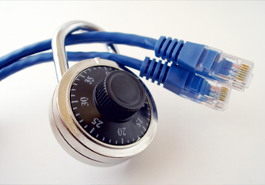
Network Protection
Use a network professional or qualified 3rd Party IT Vendor
Firewall: commercial grade hardware best
Virus & malware protection on servers, desktops, portable devices and home computers
Keep all hardware & software versions up-to-date; automatic updates best
Notes:
Internal staff: experienced and certified (continued IT & security training), attend local/national security & IT related classes.
No SOHO equipment. Manageable FWs, up-to-date maintenance subscriptions, proactively managed 24/7 by IT staff or vendor.
‘layered’ robust end-point solutions
(i.e. Symantec, McAfee, Trend Micro). Strong ‘cloud’ or ‘gateway’ protection (i.e. Appriver SecureTide, GFI, SonicWall, WatchGuard).
Laptops & home PCs (i.e. ESET, AVG, Symantec, McAfee, Trend Micro, http://www.microsoft.com/security/default.aspx
Diligently monitor/manage all critical servers & endpoints for current versions. Do the same for all management systems, backup applications, and third-party utilities.
Subscribe to security and tech articles specifically dedicated to security (CSI, TechRepublic, CIO & CSO Online, CRN, SearchCIO, etc.)

Slide 27
Physical
Secure critical equipment
Authorized access only (limit access to a ‘need to know basis’)
Secure computer room
Working area clear of PI
Physical access to the premise & work areas (locks, bio, cameras, ADT)
Tim, based on your years of doing networks assessments what are some things you’ve seen that you would like to warn our listeners about?
Notes:
Tim. Can you provide a few ‘horror stories’ of discoveries during the years of performing network assessments?
Describe actual discovered of vulnerabilities exposed during network assessments
Servers and critical equipment in open hallways. Rogue Wireless Access Points
All employees with same passwords and domain admin rights (never changed)
No locks (even doors). No environmental controls/monitoring/reporting
PI ‘paperwork’ left on desks. Unsecured filing cabinets. Un-shredded documents tossed, etc.
Open access through entries other than front door (shipping/receiving). No alarm systems.

Slide 28
Computer Protection
Servers
strong passwords; changed regularly; locked down tight
Desktop PCs
strong passwords (AsjRkx7#) & regularly changed
Staff can’t share ID’s and passwords
No storage of PI on desktops, laptops or mobile devices
Use screen saver with password protection every 15-30 minutes
Notes:
Authorized access only (admin rights and physical access)
Strong admin passwords
Monitor system Access Logs for unauthorized attempts to gain access.
Monitor Access Logs for all local and remote login attempts.
Set system for automatic forced ‘strong’ password changes every 60 days
Set system Policies (i.e. OU, system security policies) to not allow local copies and storage of PI information on local and removable devices (i.e. thumb-drives)
Invest in third-party tools that monitor/report/prevent unauthorized copying of sensitive data from the end-points (including remote users).
& Log-out when going to lunch or home for the day (especially remote home users).

Slide 29
Major Risk Prevention Tools & Procedures
Specifically, what are some tools used in agencies to help keep the systems and data secure?
Encrypt backups, thumb drives & PCs; password protect all mobile devices
Keep PI off laptops, mobile devices & home computers
Do not leave portable devices in your car - EVER
Tools you can use to encrypt devices & to wipe data from mobile devices
Internal Threat Monitoring Tools (i.e. web content filtering)
Use Real Time tool to manage carrier passwords
Single Sign-on Tools
Notes:
What are some of the tools used in agencies to help keep the systems and data secure?
File & Device Encryption Tools
Ensure local and off-site backups are encrypted during transmission and at rest (check vendor tools & procedures)
TrueCrypt, Imation Defender Collection, Sophos, SafeNet, BitLocker, Seagate FreeAgent Go Tools, etc.
Set Network policies to not allow for data to remain at rest or be copied to end-points
Period
Ensure security policy includes all devices that will have authorized remote access to company networks & data
Implement tools that can remotely ‘wipe’ remote portable devices (smart phones, PDAs, iPads).
Implement tools that can remotely locate the lost or stolen device
Tools that encrypt the entire hard drive
Internal Threat monitoring tools: Spector360, Interguard.
Agency Management Realtime Tools (i.e. Transformation Station, TransactNow).
ThirdParty: Roboform Everywhere 7, Beyondtrust, IronKey, Cyber-Ark, LastPass, PasswordBank Enterprise, etc.

Slide 30
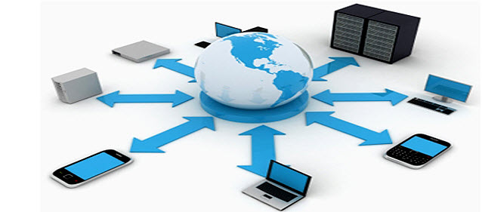
Major Risk Prevention Tools & Procedures
Connect to office through SSL / VPN connection
Use non-default password on all WiFi connections from within the agency office as well as laptops
Before discarding: destroy data on PCs, copiers, fax & scanners & other portable computers & devices. How?
Obtain written commitment from third party contractors to protect your data
Notes:
Network Admin to ensure security and operability. Ensure proper CA SSL is in place and current.
Change the default admin password, before the unit is operational within the network. Verify at least WPA2 Encryption Key is in place, and functional. Ensure unauthorized remote access is not possible. Include in company password policy (change Key every 60 days).
Ensure laptops are secured (i.e. encrypted HD, current AV/Spyware, remote wipe)
Methods
Sledgehammers, metal shredders
DoD approved software (i.e. DBAN, KillDisk, WipeDrive, SecureErase)
Shredding vendors, MFP vendors, etc.

Slide 31
How Does TLS Work?
Tell us a little more about TLS and how it works for securing daily email?
At transmission time, TLS creates an encrypted communication session between email servers The email is then sent through a protected “tunnel” The servers de-crypt the message and send it along to the client
Most agencies that have an up-to-date in-house mail server are TLS capable and there are numerous online options.
Required mode & opportunistic mode; carrier issues
Notes:
Tim… Tell us a little more about TLS and how it works.
Definition of Encryption: In cryptography, encryption is the process of transforming information (referred to as plaintext) using an algorithm (called a cipher) to make it unreadable to anyone except those possessing special knowledge, usually referred to as a key.

Slide 32
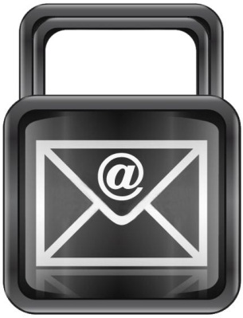
TLS (Transport Layer Security)
Most agencies that have an up-to-date in-house mail server are TLS capable and there are numerous online options.
Required mode & Opportunistic mode; carrier issues
Third Party Encryption
Rpost, Zix, CypherPost
Use when TLS mail encryption is not available (i.e. gmail, hotmail, yahoo,etc.)
Secured FTP (Third Party)
ShareFile, Kitedrive, egnyte, DropBox, filesanywhere, box
Notes:
Data at rest is not encrypted. It is only encrypted during transport between the two mail servers.
Unless agency utilizes current technologies (i.e. MS Exchange 2007 and above), user will have to manually setup TLS for each recipient mail server.
Difference between Opportunistic and Required (Mutual) TLS
Untrusted Self-signed versus Trusted CA certificate: DNS name, distinct IP address, public key, locality info.
Use secured FTP site for large attachments (i.e. anything over 10mb). Most ISPs limit email attachment sized to 20gb-50gb. These types of files will kill email server internet performance, and most likely get returned (non-deliverable).

Slide 33
Understanding ‘Layered Security’
Notes:
Tim… Why is ‘layer security’ a good practice?

Slide 34
Data
Data at rest (archived, encrypted, etc.)
Data in transit (TLS, encryption, email)
Mobile devices (PDAs, Laptops, jump drives)
Secure the Paper!
Shred the Paper!
Cloud Services
Published Apps & Virtual Desktops
Notes:
Encrypt the data in transit and at rest.
Locked filing cabinets
Certificate for shredded documents

Slide 35
Application
Agency management system up to date
3rd Party applications
Anti-Virus, Spam and Malware protection
Operating system current
Web content filtering
Internal threat monitoring apps
Email/voicemail logs
Mobile device apps for gaining access (wipe device capabilities)
Notes:
Mobile Device Security (ensure that it supports:)
Certificate-based authentication
Encrypted SSL communications
VPN client support
Hardware encryption enabled
Identify device location
Remote wipe from Exchange or Mobile Device Management Server (iCloud)
Ensure policy allows for the inspection & prevention of unauthorized devices

Slide 36
Perimeter
How can we further protect our ever growing ‘mobile community”?
Firewalls current (main office, remote offices, remote/mobile users)
Routers current (properly configured and verified on continued basis)
VPN Tunnels
Strong End-Point password policy enforced
Exposure to Public WiFi (starbucks, airports, hotels)
VoIP
Proper encryption of calls
Secure & archive all recorded conversations & voice-mail
Notes:
How can we further protect our ever growing ‘mobile community’?
Utilize the tools you already own (i.e. Windows Firewall) as an added layer of security.
Ensure that your devices are properly secured (windows FW, AV/Anti Spyware, mobile VPN, etc.)
If utilizing VoIP technologies, it is important to ensure proper encryption of the conversations and recorded conversations

Slide 37
Management
Tim, managing a network is a daunting talks, how an agency lessen the burden and expense?
Enforce all security policies (regular audits, staff training, termination)
Firewall, routers, wireless access points, remote users, etc.
Servers & workstations up to date
Remote access monitoring
Internal threat monitoring (web-content filtering, unauthorized access)
Intrusion protection
System Security Logs
Anti Virus, SPAM (i.e. Securetide)
In-house IT, Outsourced to Third-Party IT Vendor, Shared Resources (Partnership)
Notes:
No matter what the size, managing a network can be a daunting task. How can the agency lessen this burden & expense?
Cloud based applications/tools such as Appriver’s Securetide prevent loss of employee productivity, while mitigating network exposure to unsolicited and potentially dangerous emails (social engineering) or their attachments.
Describe strengths & weaknesses between In-house IT staff, outsourced IT vendor, and ‘shared IT responsibilities.
In-house:
PROs: staff readily available, can wear many hats (besides IT), usually close by, understands the heartbeat of the agency, nearby helpdesk support.
CONs: Part of payroll (costly), not 24/7 (unless bigger shop), cannot provide all necessary IT functions critical to the security of the agency, lack of expertise or continued education, vacation and sick time (uncovered network)
Outsourced
PROs: 24/7 assistance, team of experts, cost effective (flat monthly fee), forecastable investment, provide all necessary IT needs (i.e. consulting, helpdesk, network admin, project work, etc.)
CONs: Not closely held by agency, might not know the ‘heartbeat’ of the agency’s IT needs, usually not ‘on-site’ for immediate IT needs.
Partnership (Shared responsibilities)
PROs: Allows agency IT staff to concentrate on IT projects, life-cycle management, time off to regenerate, shared service desk tools, tight collaboration, services and project completed on time.
CONs: Security of Third-party IT vendor (agency greatly benefits at time the agency is having to hire another in-house tech)
Strong partnership (shared responsibilities between in-house and outsourced IT vendor.

Slide 38
Some important tips to remember
What other benefits can the agent take advantage of, by following a ‘best practices’ data security model?
Review & update your security plan at least annually, or when there is a change in law or regulation
Make sure you actually implement what you adopt in your security plan
Make sure your staff knows the importance of keeping confidential all of the information you commit to your clients to keep confidential in your privacy notices
Annual employee training; employee sensitivity to potential breaches
Monitor your staff & systems to make sure no unusual activity
The work you do on agency information security becomes an important value add to the risk management services you provide your clients.
Notes:
What other benefits can the agent take advantage of, by following a ‘best practices’ model?
Besides mitigating their risk of exposure, liability, and incrimination… the benefits of increased network and employee productivity, and their ability to use their expertise with educating their existing and potential clients on the importance of security and investments in E&O coverage.
The work you do on agency information security becomes an important value add to the risk management services you provide your clients.
And can lead to the generation of new revenues in E&O coverage.
Hold security seminars within your local business chapters.
Partner with your reputable and proven IT vendor to help assist your client in this area (offer their services and consulting to your clients).

Slide 39
Tools and Resource

Slide 40
Agency Information Security Resources
ACT has developed a ton of information for members in the area of privacy and security. Jeff, can you please provide an overview of this material and where our listeners can find it?
“Security & Privacy” Page on ACT Website (iiaba.net/ACT)
ACT’s Prototype Agency Information Security Plan
ACT Information on Secure Email using TLS
Combat Cybercrime and Protect Your Agency with Simple Security Steps
Don't Get Caught in the Web!
Agency E&O Considerations When Using Social Media
Creating a Social Web Policy for your Agency

Slide 41
Agency Information Security Resources
State Data Breach Notification Laws compiled by National Conference of State Legislatures (www.ncsl.org)
Once More Unto the Breach: An Analysis of Legal, Technological and Policy Issues Involving Data Breach Notification Statutes, Dana Lesemann, Akron Intellectual Property Journal
HIPAA Information from U.S. Department of Health & Human Resources (hhs.gov)
Info on Gramm Leach Bliley ; See also legal paper at IIABA Legal Advocacy at “Memoranda & FAQs” link (members must login)

Slide 42
Agents E&O Coverage

Slide 43
DEFINITION OF PERSONAL DATA
Now let’s talk about some of the insurance remedies to protect the agency against liability. In July, Swiss Re worked with the Big “I” to introduce a new, state-of-the-art policy, Susan can you tell a little about the coverage available under the Swiss Re agents E&O policy.
Personal Data means all non-public information, whether written, or electronic:
1. including but not limited to, any social security number or biometric records, which when used alone, or when combined with other personal or identifying information, such as date and place of birth, or mother's maiden name, is linked or linkable to a specific individual;
2. concerning an individual that would be considered protected health information as defined within the Health Insurance Portability and Accountability Act of 1996; or
3. that would be considered non-public personal information within the meaning of the Gramm-Leach Bliley Act or similar state, federal and foreign identity theft and privacy protection legislation applicable to the breach

Slide 44
FIRST PARTY COVERAGE
Covers breach of agency network security compromising customer's Personal Data
Covered expenses:
- Consult with legal counsel
- Consult with IT
- Assist in notification
Automatic coverage for all IIABA policyholders
Sublimit of $10,000 per claim/ $25,000 aggregate
Deductible $1,000 per incident

Slide 45
THIRD PARTY COVERAGE
Covers Breach of Personal Data in rendering Professional Services or Other Related Services
Available on broadest policy form (not available on Basic policy form)
Sublimit of $1,000,000
Eligibility requirement-
Security procedures to protect personal data during transmission
Exclusions:
Non-compliance with state and federal privacy regulations
Failure to implement protective measures

Slide 46
Coverage for Clients

Slide 47
Should agents have stand-alone coverage?
Even with the coverage available in their E&O policy form, should agencies consider a stand-alone policy? If so, why?
It is good that there is some coverage available from Westport’s agents E&O policy. Simply put, having “some” is better than “none”. The following are reasons agents should consider their own policy:
Considerations
Is $10K/$25K limits enough 1st party protection to cover a claim? Maybe not.
You need enough limits to provide notification and monitoring if required by law.
Beyond notification and monitoring, the agency will need enough limits to also cover liability as a result of a breach. After notification, there can be significant liability.
The agency needs to protect the bottom line, and this type of loss could impact an agency’s survival.

Slide 48
Other considerations for the agency purchasing separate coverage:
Protect Your Agents E&O Policy
Required in some states and by almost all insurance companies require E&O.
Keep it separate: A Privacy & Security claim does not impact the agency’s E&O coverage.
If there are losses under the agents E&O policy for Privacy & Security, it impacts an agency’s loss ratio and can increase E&O costs over the long haul.
Obtaining broader coverage should be a consideration.
Coverage is claims made, so establishing a retroactive date is important under Privacy & Security insurance.
If can afford to buy it, you should.

Slide 49
Why offer Cyber Liability to Your Customers?
Why should agents be offering cyber liability insurance to their customers?
It is unlikely there will be coverage under other types of policies.
Commercial General Liability (CGL) and Business Owner Packages are adding exclusions. Even if there is no exclusion, the losses are economic. CGL policies are triggered by bodily injury or “tangible” property damage.
The cost of a breach goes far beyond hard costs. The time it takes to cover a claim is significant. Time cost is multiplied when you do not have insurance to cover it.
Insurance companies that provide cyber coverage have been through the claim process. They know who to contact. They will properly respond to situations. Customers without insurance need to do extra research or hire people to respond to a data breach.
Beyond the hard costs and cost of time, there is also a public relations loss after a breach. Customers might leave because they view the Insured as careless with their data.

Slide 50
Offering Privacy & Security Coverage to Agency Customers
Without question, agencies should offer Privacy & Security insurance to ALL clients. (Avoid failure to offer E&O coverage claims!)
Make Privacy & Security insurance part of your agency coverage checklists.
Like EPL in the past, Privacy & Security insurance has been slow to catch on.
The poor economy has not helped, but hit ratios for Privacy & Security insurance are increasing.
The market is still relatively soft, so after saving premium under other lines, there may be room in the budget of many insureds to consider privacy & security insurance.

Slide 51
Understanding Coverage - Privacy & Security Policies
Can you provide our listeners with a high-level overview of the cyber policies including what to look for and which customers to target?
Liability coverage – protection against lawsuits resulting from data breach.
Notification and monitoring – 1st party coverage for the expenses.
Regulatory action coverage – this is critical when dealing with regulators. For example, this coverage would be needed when providing notification to a state’s attorney general.
Extortion coverage – It seems unlikely, but happens to some companies.
Regulatory action fines and penalties – this may or may not be insurable.
Website media liability – libel, slander, disparagement, copyright, trademark, etc. This might not be covered by a company’s general liability policy.

Slide 52
What to look for in a Privacy & Security Policy
Many insurance companies have jumped into this line of coverage. Some estimate 40 companies offer the coverage in some way shape or form.
Every company has different terminology. Some call it Data Breach. Others call it Privacy & Security. It is very confusing.
Most companies claim their coverage is the “best and broadest”, and the companies will list reasons their product is superior.
Most companies will admit they have not had a lot of claim activity.
Today, we do not know which policies are the best and broadest because the policies have not been tested.
Focus on coverage triggers and limits. Agencies should look for a policy that is triggered by loss of electronic and non-electronic data. The policy should have enough limits to cover liability and the 1st party notification and monitoring, which is often sub-limited.

Slide 53
Clients in need of Privacy & Security Insurance
As previously mentioned, the coverage should come up with all client insureds.
Insureds who have Personal Identifiable information need the coverage.
Segments where it is absolutely critical: healthcare, retail, and financial.
Large or small – do not feel a risk does not have exposure because they are a small business. Mom and Pop retailers can be a big target.
The submission process brings value to a client and might result in awareness of the exposure and potential weakness in their systems. For example, a client might not be encrypting. The submission process might make a client take a look and improve their systems.
If an agent does not offer the coverage, it can be an E&O, and it can lead to the loss of an account because another agent made a client aware of the exposure.

Slide 54
The marketplace
Describe what you are seeing in the marketplace for this product.
The number of companies offering coverage is increasing.
Coverage is getting broader, but as losses eventually surface, the coverage might become more restrictive in some ways. This is similar to pollution exclusions being added to GL policies in the 1970s.
Minimum premiums have dropped. It is now affordable for most clients. At a minimum, the coverage should be brought up and considered.
Bottom line – agents need to protect their clients. Privacy & Security insurance should be offered.

Slide 55
Coming Soon to Big “I” Markets:
In need of a market and expertise for Cyber Risk Insurance Policies?
Big “I” Markets will working with A.J. Wayne and Associates to provide a product soon.
If you are not offering Cyber coverage to your customers you should be. The result will be more revenue, less E&O exposure, and greater protection for customers.
Visit www.bigimarkets.com to learn more about what’s available.

Slide 56
Feb. 8th - Cyber Risk Webinar Opportunity from IIABA
This webinar identifies existing and evolving cyber risk exposures, details why traditional insurance products are inadequate to manage these exposures, and outlines potential solutions from ISO standard products and various specialty programs available in the insurance marketplace. At the conclusion of this webinar, participants should be able to: • Grasp the significance and magnitude of cyber exposures • Understand why traditional standard insurance products are inadequate to address these exposures • Differentiate between various ISO solutions and recognize why most are inadequate • Identify what non-ISO specialty products cover or should cover
TO REGISTER: Visit the Upcoming Webinars section of www.iiaba.net or click here.

Slide 57
Thank you
Corporate Solutions

Slide 58
Legal notice
©2011 Swiss Re. All rights reserved. You are not permitted to create any modifications or derivatives of this presentation or to use it for commercial or other public purposes without the prior written permission of Swiss Re.
Although all the information used was taken from reliable sources, Swiss Re does not accept any responsibility for the accuracy or comprehensiveness of the details given. All liability for the accuracy and completeness thereof or for any damage resulting from the use of the information contained in this presentation is expressly excluded. Under no circumstances shall Swiss Re or its Group companies be liable for any financial and/or consequential loss relating to this presentation.

